Slide 1
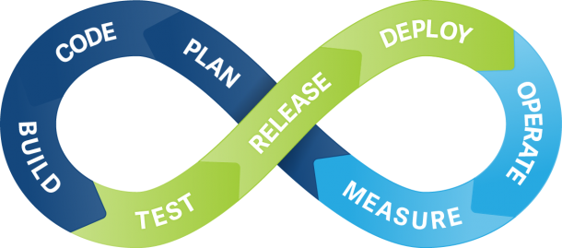
Introduction to Continuous Integration
Jenkins Continuous Build System

Slide 2
Contents
Continuous Integration (CI)
What is it ?
CI- Workflow
What are the Benefits ?
CI – Best Practices
How CI is Done ?
Jenkins
What is it ?

Slide 3
Continuous Integration
“Continuous Integration is a software development practice where members of a team integrate their work frequently, usually each person integrates at least daily - leading to multiple integrations per day. Each integration is verified by an automated build (including test) to detect integration errors as quickly as possible”

Slide 4
CI – What does it really mean ?
At a regular frequency (ideally at every commit), the system is:
Integrated
All changes up until that point are combined into the project
Built
The code is compiled into an executable or package
Tested
Automated test suites are run
Archived
Versioned and stored so it can be distributed as is, if desired
Deployed
Loaded onto a system where the developers can interact with it

Slide 5

CI -Workflow
Regular
Interval
Continuous Build System
Artifact Repository
Code Repository
Executable/
Package
Testing Results
Source & Tests
Deployment
Test Reports

Slide 6
CI - Benefits
Prevents Integration problems
Integration bugs are detected early and are easy to track down due to small change sets.
A deployable artifact is obtained at any given point.
Automatic Build , Automatic deployment ,self-testing Build .
Continuous Integration is quality assurance
When unit tests fail or a bug emerges, if developers need to revert the codebase to a bug-free state without debugging, only a small number of changes are lost (because integration happens frequently)
Using continuous feedback mechanisms

Slide 7
CI – Best Practices
Maintain a single source repository
Automate the build
Make the build self-testing
Everyone commits to the baseline every day
Every commit (to baseline) should be built
Test in a clone of the production environment
Make it easy to get the latest deliverables
Automate deployment

Slide 8
How CI is done ?
Developers check out into their private workspaces,
When done, commit changes to the repository.
CI server monitors the repository and checks out changes when they occur, it builds the system and runs and integrate the tests.
CI server releases deployable artifacts for testing and assigns a build label to the version of the code it just built.
CI server informs the team of the successful build.
If build fails the server alerts the team.

Slide 9
CI - Tools
Source Code Management
GIT, Mercurial, Jazz
Continuous Integration
Travis CI, Jenkins, CodeShip, Bamboo, Circle CI
Containers
Docker, ElasticBox, XebiaLabs
Testing
Junit, Selenium, Cucumber
Monitoring
Nagios, Airbrake, Librato
Configuration Management
Puppet, CHEF, SmartFrog
Deployment
Deploy, Ansible, Vagrant
Build
Maven, Gradle, ANT

Slide 10

Introduction to Jenkins
Java Based Continuous Build System
Branched From Hudson
Self contained, open source automation server which can be used to automate all sorts of tasks related to building, testing and delivering software.
Supported by over 400 plugins
SCM, Testing, Notifications, Reporting, Artifacts saving, Triggers
http://Jenkins-ci.org/

Slide 11
Jenkins – Fitting In
Regular
Interval
Artifact Repository
Code Repository
Executable/
Package
Testing Results
Source & Tests
Deployment
Test Reports

Slide 12
Why Jenkins ?
Jenkins is a highly configurable system by itself
The additional community developed plugins provide even more flexibility
By combining Jenkins with Ant, Gradle, or other Build Automation tools, the possibilities are limitless
Lower The Effort Of Converting CLI To GUI.
Pipeline Integrates Individual Jobs For A Bigger Purpose.
There is a large support community and thorough documentation
Native/Supported packages exist for
Windows, Ubuntu, Redhat/Fedora/CentOS, Mac OSX, Solaris

Slide 13
Part 2 Getting Started with Jenkins
Prerequisites
A machine with:
256 MB of RAM, although more than 512MB is recommended
10 GB of drive space (for Jenkins and your Docker image)
The following software installed:
Java 8 (either a JRE or Java Development Kit (JDK) is fine)
Docker for Windows

Slide 14
Download and run Jenkins
Download Jenkins
https://jenkins.io/download/thank-you-downloading-windows-installer-stable/
Run Jenkins setup
Browse to http://localhost:8080
Follow the instructions to complete the installation.

Slide 15
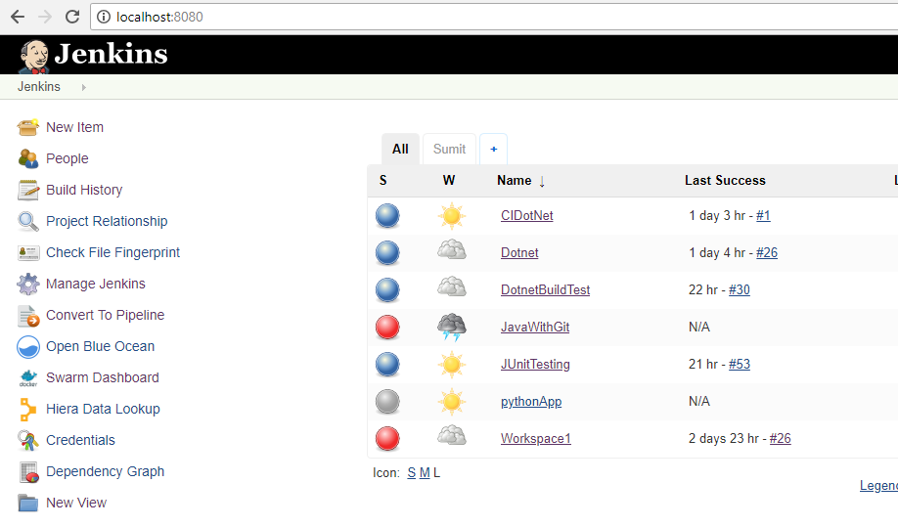
Configuring Jenkins
Configure Jenkins

Slide 16
Downloading and Configuring Plugins
Plugins to be downloaded
Team Concert Plugin
Build Toolkit Plugin
Junit Plugin
JDK plugin
MS
Build Plugin
Ant Plugin
VSTest Plugin
Email Extension Plugin
Pipeline Plugins
NuGet Plugin
Maven Plugin
Go to manage Plugins to download and install plugins
Select the option: Install without restart
After installing plugins restart Jenkins to configure them
If facing some issues (Error: Connection refused by remote server), add Proxy configuration in Manage Plugins-> Advanced Tab.

Slide 17
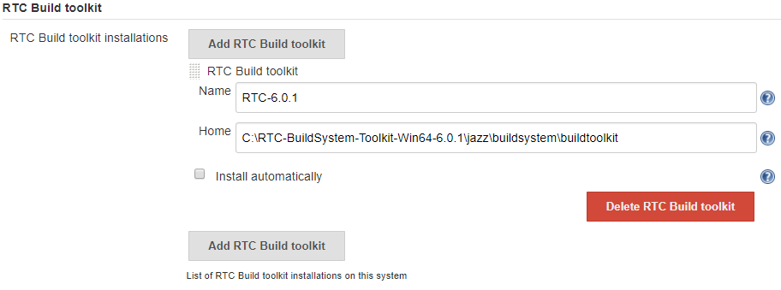
Configuring RTC-Build Toolkit Plugin
Go to Global Team Configuration in Manage Jenkins .
Give a default name and RTC Build Toolkit Installation directory.
Uncheck Install Automatically option, Save the Configuration .

Slide 18
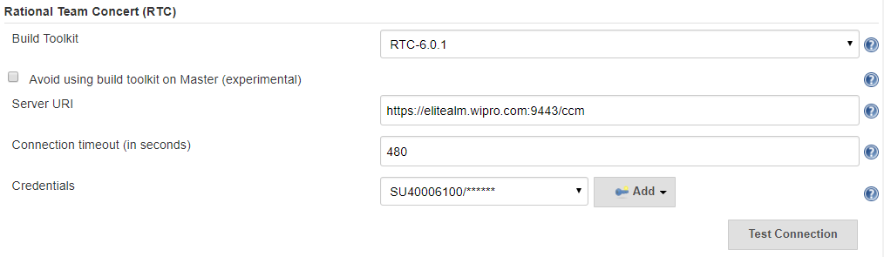
Configuring Rational Team Concert Plugin and Jazz Server
Go to Configure System in Manage Jenkins
Select the Build Toolkit version installed, enter the SCM URI
Enter credentials (username/Password) and Test Connection.
Connection should be successful, as shown in Screenshot.
Connection test was successful

Slide 19
Configuring Other Tools
Configure Other Tools shown in Global Tool Configuration, as we configured RTC-Build Toolkit.
Add a default name and Installation Directory of tools.
Configure
JDK, MSBuild, ANT, Maven, Docker
MSBuild’s Home Directory
C:\Windows\Microsoft.NET\Framework\v4.0.30319
ANT- download Apache-ANT and Home Directory
C:\apache-ant-1.10.3
Maven- download Apache-Maven, Home Directory
D:\apache-maven-3.5.3
Docker’s Home Directory
C:\Program Files\Docker\Docker

Slide 20
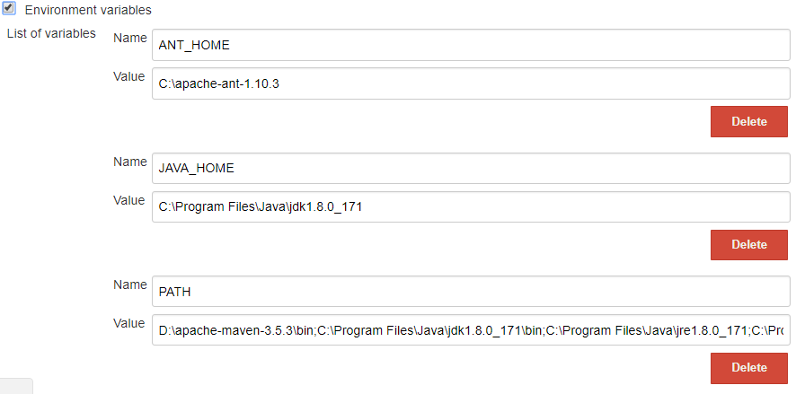
Some more Settings
Go to manage Jenkins-> manage Nodes,
Select master node, go to Configure and check Environment Variables option
Set variables as given in screenshot, value of Path variable is same as your System Path.

Slide 21
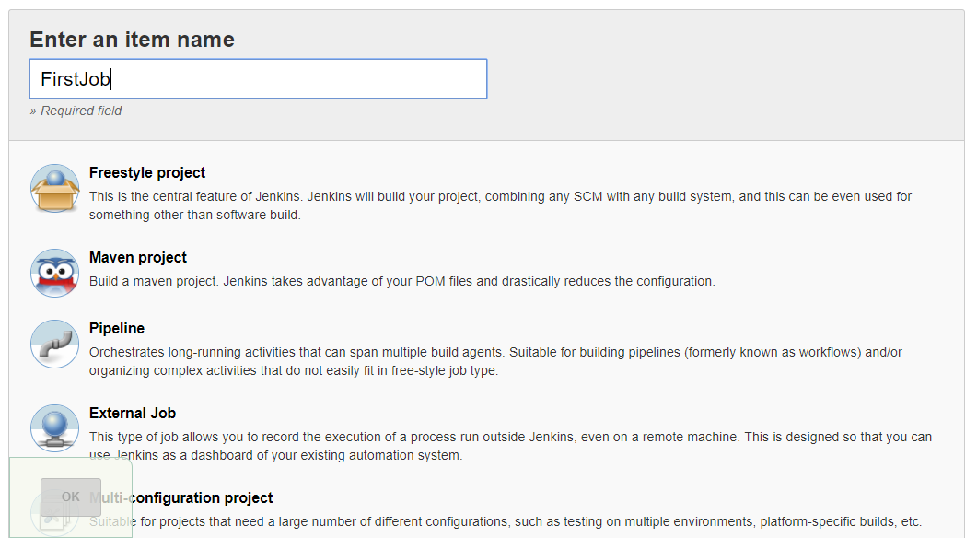
Creating First Job in Jenkins
In Jenkins Home page click on New Item and enter a job name
Select Freestyle Project and click ok

Slide 22
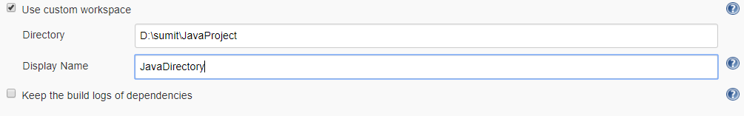
Configuring Job (Running a Java Application)
General
If you want to use your own Workspace, in Advanced tab select custom workspace and add details.
Source Code Management
Select Rational Team Concert and configure it,

Slide 23
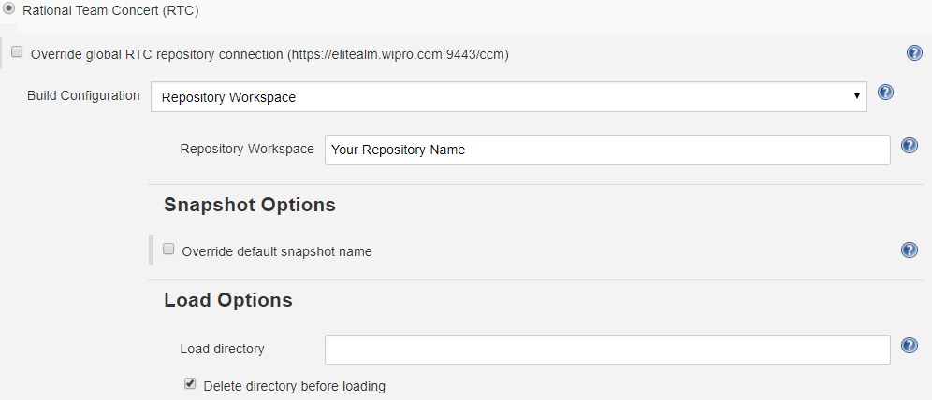
More Options
Your Directory name (/Home/)
Enter the details as shown in the above screenshot.
Also check the “Delete Directory before loading option”.
All your Files will be downloaded from Jazz Server into the load directory, inside your workspace.

Slide 24
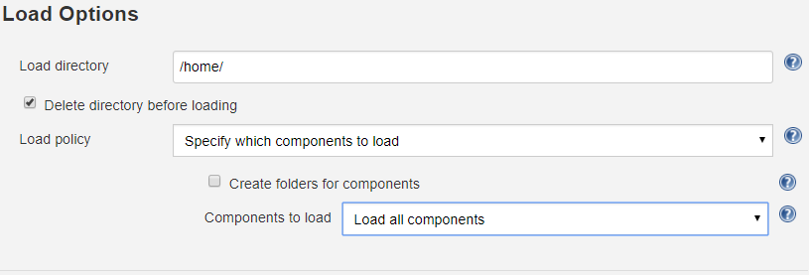
Mention the Load directory, it is the folder where all your components would be downloaded from Jazz Server.
In components to load field, select Load all components or Exclude some components based on your requirement.
If you select Exclude some Components , then you must mention the name of components to exclude in the box that appears below separated with commas (Name should be same as in the WORKSPACE).

Slide 25
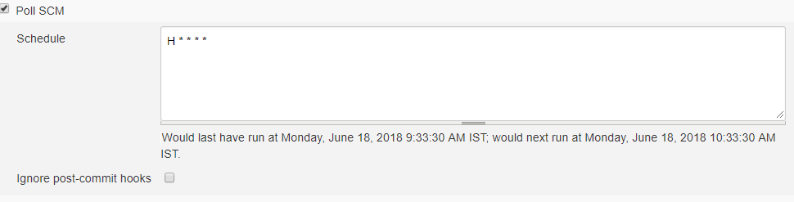
Build Triggers
Select Poll SCM and enter the schedule as (H * * * *) , which means Build occurs every hour.
You can enter any schedule based on requirement.
Example, (* * * * *) means every minute.
Build Environment
select delete workspace before build starts, however it is optional.

Slide 26
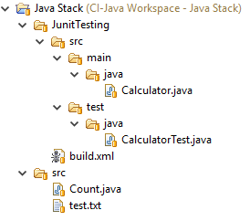
Java files used for Project

Slide 27
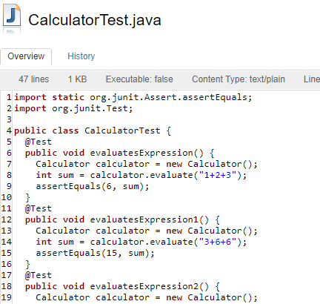
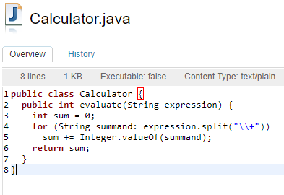
Java Source File and Test File

Slide 28
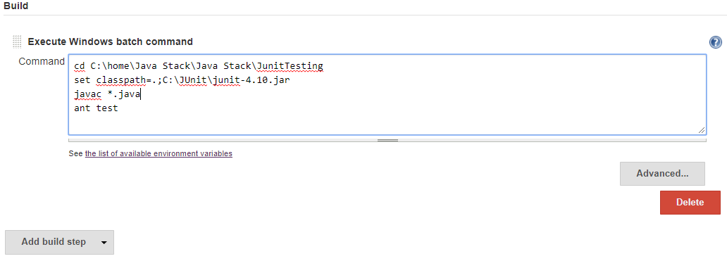
Build
Click on Add Build Step and then select desired option based on how you want to run and test the application.
This example uses Windows Batch Command for compiling Java programs, and running JUnit Tests using ANT.
You can add more than one build Step.

Slide 29
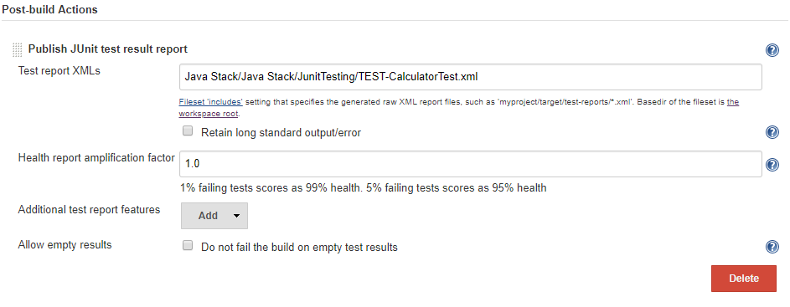
Post-Build Actions
Click on Add a Post-Build Step and select Publish JUnit Test Result Report
This example creates Test Reports in XML form so directory of XMLs is provided there (Imp: Directory of XML is relative to workspace).
If you are Building an application, you can also select Archive artifacts which downloads and stores .EXEs .

Slide 30
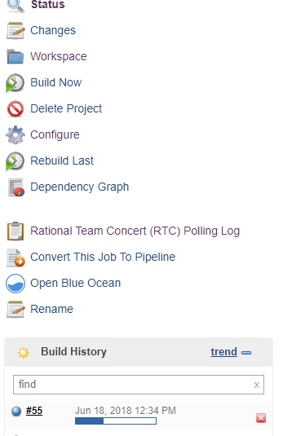
Building Project
After configuring the Build Definition click on Save button
Click on Build Now option to start the Build
To see ongoing Build Process Click on the ongoing Build in Build History , then click on console output shown in the next Page.

Slide 31
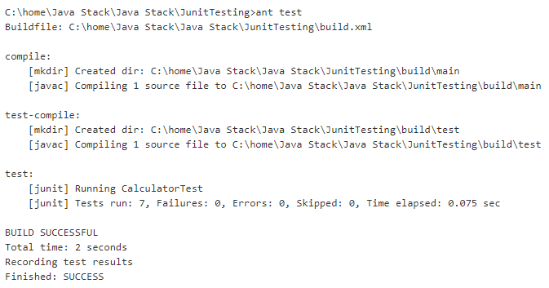
Console Output
Shows that build is Success.

Slide 32
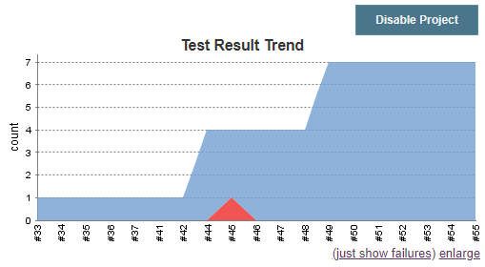
Test result Trend
Blue area shows Passed test Cases
Red Area Shows Failed test Cases.

Slide 33
CI of .NET Applications
Some Important Plugins needed for CI of .NET applications are
MSBuild Plugin
NuGet Plugin
Configure these plugins in Global Tool Configuration and also set the Path in Master Node.
Create a .NET project in VS17, also add a Unit Test Project to it(This Feature is available only above VS17).

Slide 34
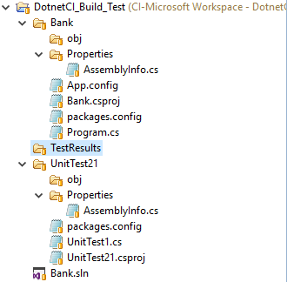
Project and other files used in Example
Create a console application and one unit Test project which is referenced to it.
.Dll and .exe should not be present.
Creating a sample project is shown here
https://www.c-sharpcorner.com/UploadFile/7ca517/unit-test-with-console-application/
Create a new job in Jenkins configure SCM, Build Triggers and leave the other steps just check connection is working or not.
Build should be success.

Slide 35
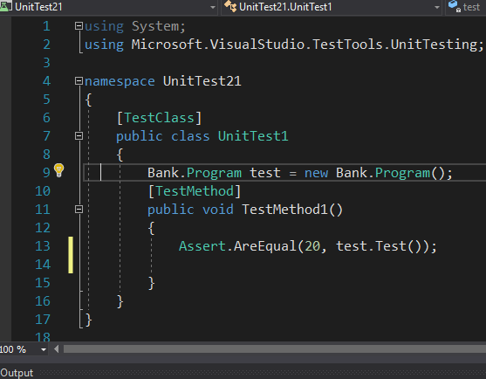
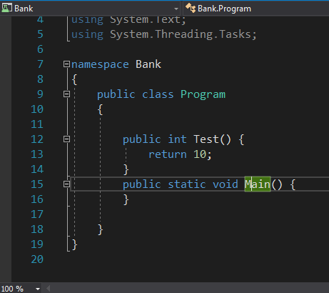
Application and Unit Test Files
Unit Test File
Program file

Slide 36
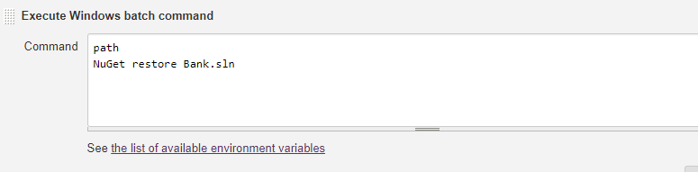
Configuring Jenkins Job (Build)
In Build step, click on add Build Step and select Execute Windows Batch Command.
Path just gives the Path variable set in Master Node,
NuGet restore commands, restores the packages that we were not allowed to upload in RTC, and were used by our project.
**Imp: Path NuGet should be set and shown in Environments Variables appearing below Command Line.

Slide 37
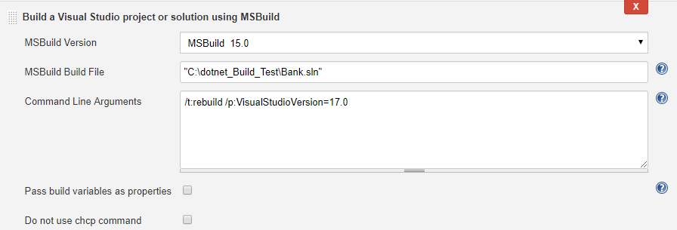
Click again on add Build Step and select Build a Visual Studio project or solution using MSBuild
Select the MSBuild version installed.
Specify the directory of the solution which is to be build using MSBuild.
Command Line Argument mentioned is a MSBuild command which builds the solution.
The number written at the last is the Visual studio version=17.0.

Slide 38
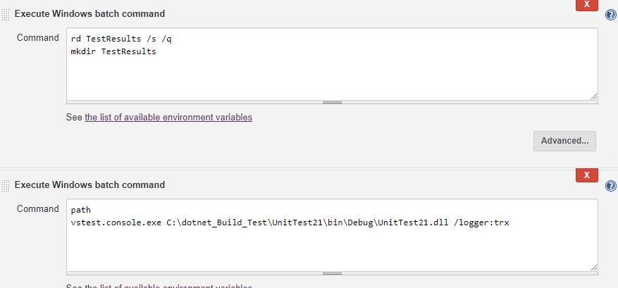
Again add a build Step and select Execute Windows Batch Command,
In this example next step again is again Execute windows cmd in which Testing is done, This can be done either by vstest.console.exe or from cmd line also.
These two steps can be merged to single a step also.
We need to remove the original TestResults directory and create a new one.
Then the vstest.console.exe runs the Unit Test application and Vstest console and creates .trx file to store results.

Slide 39
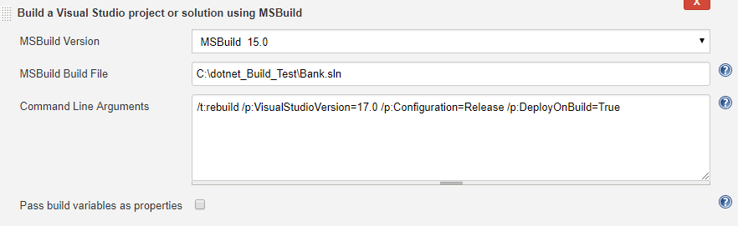
Add another build step, select Build a visual studio Project using MSBuild.
Specify the location of .sln file
Enter the cmd below, this command builds the solution in release mode.

Slide 40
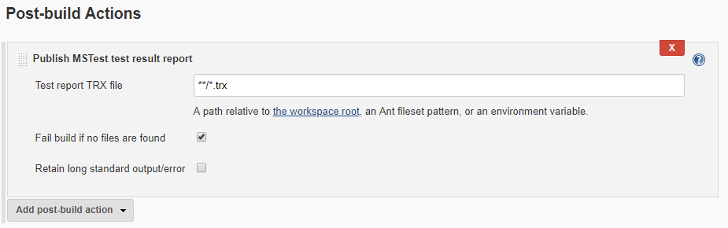
Post-Build Actions
Click on add Post-Build action and select Publish MSTest test result report
Let it be as it is , or as the ANT regular expression shown above.
Remember: If you are using any private workspace other than that of Jenkins then you need to mention it in SCM Section in Advanced tab.

Slide 41
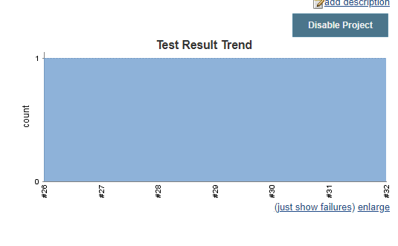
Save and Build your Project and ensure it is a success.
You can also check Test result Trends.

Slide 42
Some Common Errors and their Solutions
Command is not recognized as internal or external command
Check The Path of the Tool , and also check if its installation directory is specified properly in Global Tool Configuration.
Publish Test Results cannot find files
It is because this plugin searches for files in its workspace, switch the workspace if using private and specify the relative path to the test Results file.
Try to use ANT regular expressions.

Slide 43
Thank You

